Slide 1

Computer Programming 44
University of Montevallo
Spring 2021

Slide 2
A smart way of dealing with tables in java

Slide 3

What is our session about today?

Slide 4
Reading a CSV file into a Java program

Slide 5
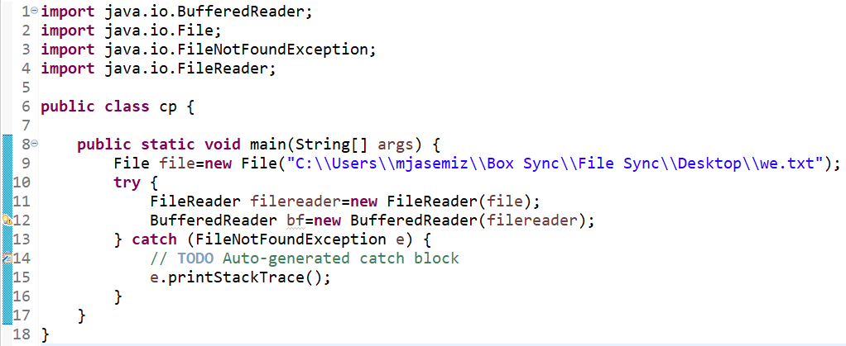
how to read a CSV file into Java (1/3)
Class of BufferrdReader is used to read the data of the input read file.
BufferedReader name=new BufferedReader(the FileReader object)

Slide 6
how to read a CSV file into Java (2/3)
readLine is a method of BufferedReader class.
This method reads a line of text. A line is considered to be terminated by any one of a line feed ('\n'), a carriage return ('\r'), or a carriage return followed immediately by a linefeed ‘\r\n’.
It reads only the line the cursor is pointing to.
With each run it reads only one line. To read more lines you have to run it more time.
Has to be written in the try code block of try-catch statement.

Slide 7
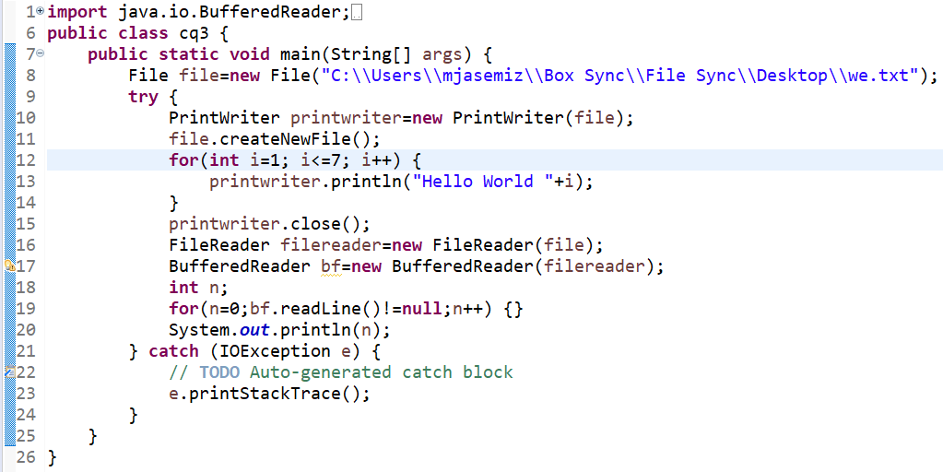
how to read a CSV file into Java (3/3)

Slide 8
Activity 1
Note: The next slide is the answer to this activity so do not proceed until you are done with the activity.
Download binary.csv from Canvas, then read it and print it on the console through a Java program.

Slide 9
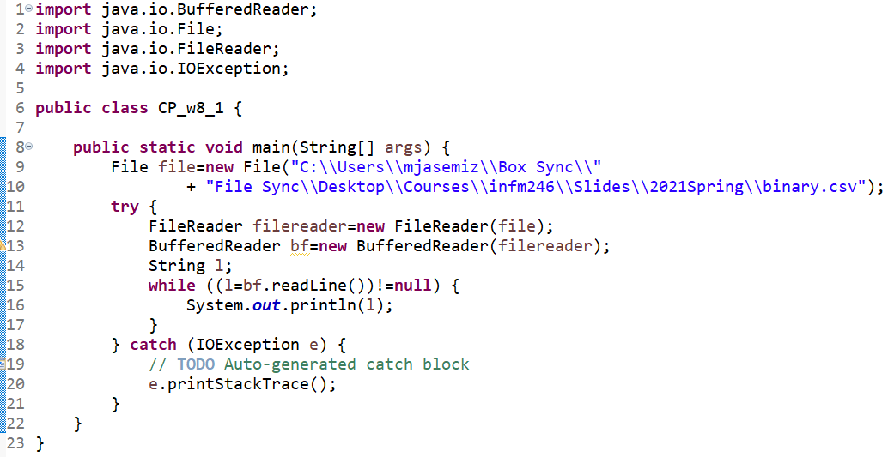

Slide 10
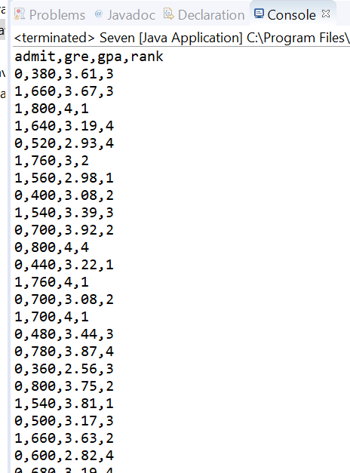
What you should see on your console after running the program

Slide 11
Another way of reading a CSV file in Java

Slide 12
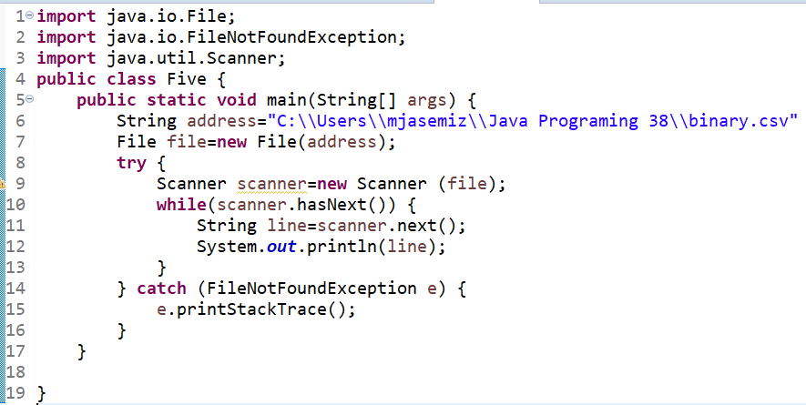

Slide 13
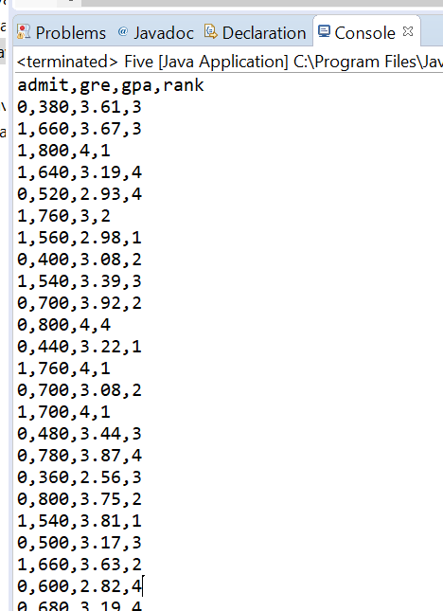
What you should see on your console after running the program

Slide 14
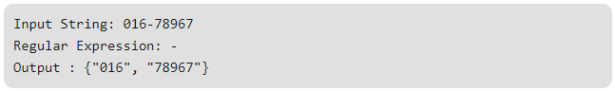
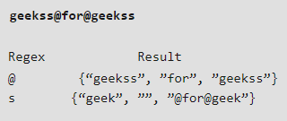
split(String RegExp)
The Split method breaks a given string around matches of the given regular expression.
The constructor:
“The string object”.split(“the regular expression”)

Slide 15

Activity 2
Note: The next slide is the answer to this activity so do not proceed until you are done with the activity.
Write a code that splits “GeeksforGeeks: A Computer Science Portal” according to “:” and prints out all the array elements.

Slide 16
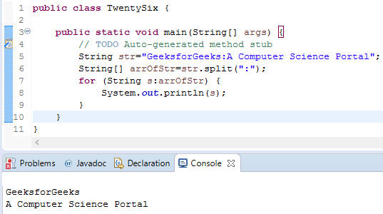

Slide 17
Activity 3
Note: The next slide is the answer to this activity so do not proceed until you are done with the activity.
Continue activity 2 by changing the regular expression to “e” and run your code again.
Make sure you fully understand the logic behind the output on the console.

Slide 18
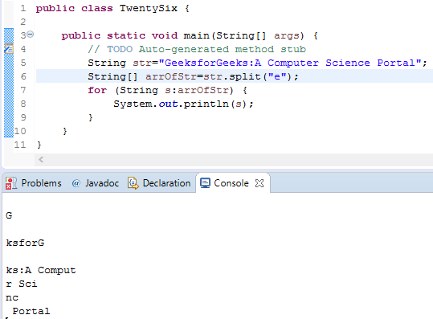

Slide 19
Activity 4
Note: The next slide is the answer to this activity so do not proceed until you are done with the activity.
Explain for yourself a programming strategy to print out only the 3rd column (GPA) of binary.csv on the console. That is, at this step no java programming is necessary and you are just explaining how you are programming it if you want to do so.

Slide 20
Activity 4 discussion

Slide 21
Stay Safe & Happy

